Slide 1
Layered Application Development
Litsietsi Montsi
MSc Eng. Wits
BSc Hons. UP
BSc NUL

Slide 2
Contents
Background
The layers
Implementing frameworks
Presentation Layer
Business logic layer
Integration (Persistence layer)
Practical
Further reading
Assignment

Slide 3
Background
In the present day, software is no-longer developed from scratch.
Think of an assembly line where components are created from various sources then assembled to create a finished product.
The usual software development process from an architectural perspective :
Software reference Architecture
Architectural pattern
Framework
Application

Slide 4
Background
Examples
ICT field | Architectural pattern | Software reference Architecture | Framework | Application
Enterprise software development | Layered architectural pattern | Java EE | Java EE complain application servers (Jboss, Glassfish, weblogic) | FNB online banking, Many others apllications
Enterprise software development | Layered architectural pattern |  | Microsoft Dot net | many sites developed using this
Automobile Software industry | Layered architectural pattern | AUTOSAR | Arctic Core, MICROSAR
Enterprise software development | Microkernel architectural pattern | Operating systems, SOA | Linux OS SOA : SOA ADF, Many ESBs | Many corporate systems where integration and reusability is a priority

Slide 5
Background
Links to the above examples
Enterprise software development
Java EE : https://www.oracle.com/technetwork/java/javaee/overview/compatibility-jsp-136984.html
Automobile industry
https://www.autosar.org/
https://www.methodpark.de/blog/autosar-part-1-the-classic-platform/

Slide 6
Background
Layered application development is based on the layered architectural pattern.
The layered architectural pattern is best practice for Separation of Concerns design principle. (google this)
The concerns that layering address in the context of Enterprise systems are :
How does a system effectively present information to a user?
How does a system deliver effective processing of business logic?
How does a system integrate seamlessly to other Enterprise systems?

Slide 7
The Layers
The layers in application software development are as follows:
Presentation Layer
Logic / Business Layer
Integration Layer

Slide 8
Implementing frame works
Microsoft Dot.NET
Java EE
Spring
Other language frameworks

Slide 9
Layers Technology translation
The layers have technology that fulfils each functionality of each layers.
The generic technology in each layers is as follows:
MVC Framework/front end technology
Aspect Oriented Programming
Business logic execution technology
Integration technology (ORM/Adapters)

Slide 10
Microsoft Dot Net
Layered architecture MS dot Net implementation
ASP.net webforms /ASP.net MVC/windows forms
ASP.net web API / C# classes
ADO.NET/linq2sql/Entity Framework
MS SQL
Other systems

Slide 11
Java EE
Java EE implantation of Layering
Browser
Devices
Desktop client
Other clients
JSF/JSP/servlets
DTO
EJBs (Stateless/stateful session beans,MDBs)
DAO
JPA/Hibernate/JCA
DBMS
Other EA

Slide 12
Presentation Layer
Presentation Layer is all about presenting data to the user.
The user can be a human user, through a browser or another device.
The presentation can also be done to other machines via an API.
Usually webservice APIs are part of the presentation if it is not to a human user.
Model View Controller (MVC) frameworks are used in this layer if the user is a human through a browser to optimize customer experience and make simplify implementation for the developer.

Slide 13
Presentation layer
There are several MVC frameworks for front-end development.
These are:
Angular
React
Vue.js
JSF (Java EE)
Spring MVC (java Spring)
ASP.NET MVC (MS Dot NET)
Giotto (python)
turboGears (python)
E.t.c

Slide 14
Presentation Layer
MVC frame works have 3 basic components
Model : this maps to user data input and stores it (usually a class that just holds data)
View : these are user interface components that user sees (GUI).
Controller : this controls UI components and coordinates input to model (usually a class with orchestration logic).

Slide 15
Logic / Business Layer
This is the layer that focuses on business logic execution.
The components in this layer are optimized for (non-functional requirements) :
Concurrent execution
Thread creation
Thread management
Security
Authentication and Authorization
Encryption
Scalability
Object pooling and thread pooling
Transaction management

Slide 16
Logic / Business Layer
In java, this layer is presented by beans. Beans are classes with logic whose lifecycle are managed by application server.
In Spring, these are called spring beans.
Managed by the Spring container
In java EE, these are called Enterprise Java Beans (EJBs)
Managed by the EJB container
The non-functional requirements mentioned on the previous slide are delegated to containers where they are executed.

Slide 17
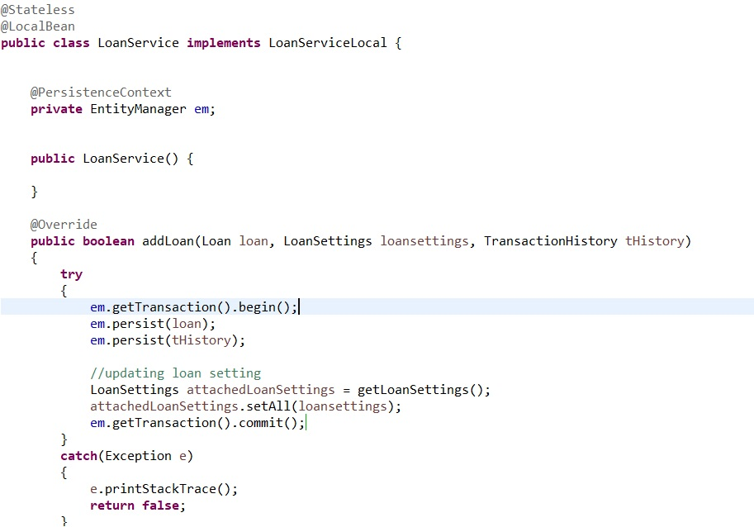
Bean managed transaction example

Slide 18
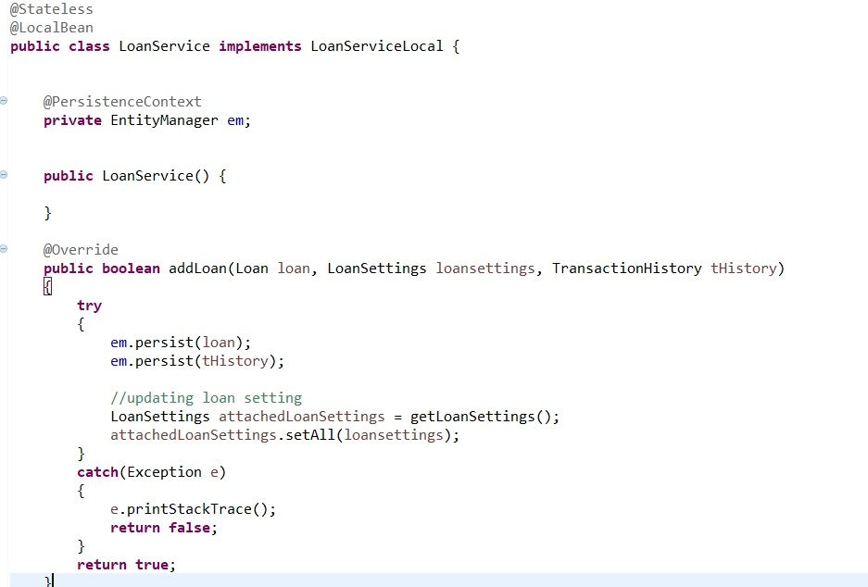
Container managed transactions

Slide 19
Integration Layer
This is the layer that is responsible to all integration to other systems.
The systems that an enterprise system could integrate to are:
Other enterprise systems
Database Management server
RDBMS
NoSQL
Older legacy systems
Message queues
Publish subscribe
Point to point
API integration services

Slide 20
Practical Demo
Done in class

Slide 21
Practical assignment
Create an mvc front-end for a login screen that uses a hard-coded password and user-name.
Extend your work from the above:
Store users in the database with user-name and password.
Use a different Database management server than the one used above.

Slide 22
Assignment 1
Clone the example given in class
https://github.com/LMontsi/employeemanagement.git
Create a retrieval of employees from the database and display a list of employees on the screen.
Use online material for guidance
http://www.thejavageek.com/2015/01/09/creating-jsf-ejb-jpa-application-using-eclipse-wildfly/
Assignment due : 29/08/2019 23:59
Submit by uploading you code to GitHub and email the link to your repository to the lecturer.

Slide 23
Detailed recommended reading
Read and practice using the link below the follow the demo in class:
http://www.thejavageek.com/2015/01/09/creating-jsf-ejb-jpa-application-using-eclipse-wildfly/

Slide 24
Further reading
https://programmingwithmosh.com/asp-net/layered-architecture/
https://docs.microsoft.com/en-us/dotnet/architecture/modern-web-apps-azure/common-web-application-architectures
https://aspnetboilerplate.com/Pages/Documents/NLayer-Architecture
https://blog.scottlogic.com/2013/12/06/JavaScript-MVC-frameworks.html

